Slide 1

Deep Reinforcement Learning-Based Network Slicing for Beyond 5G
K. Suh, S. Kim, Y. Ahn, S. Kim, H. Ju and B. Shim, "Deep Reinforcement Learning-Based Network Slicing for Beyond 5G," in IEEE Access, vol. 10, pp. 7384-7395, 2022, doi: 10.1109/ACCESS.2022.3141789

Slide 2
Introduction
5G network is a multi-network service having wide range of services such as:
Enhanced mobile broadband (eMBB)
Ultra reliable and low latency communications (URLLC)
Massive machine-type communications (mMTC)
This paper works with resource allocation over the network slices among these three services using deep reinforcement learning algorithm.

Slide 3
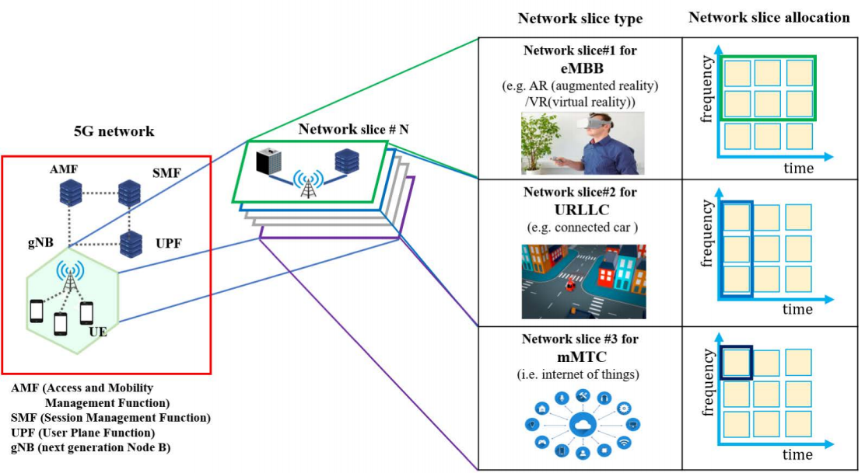
Illustration of network slicing in 5G

Slide 4
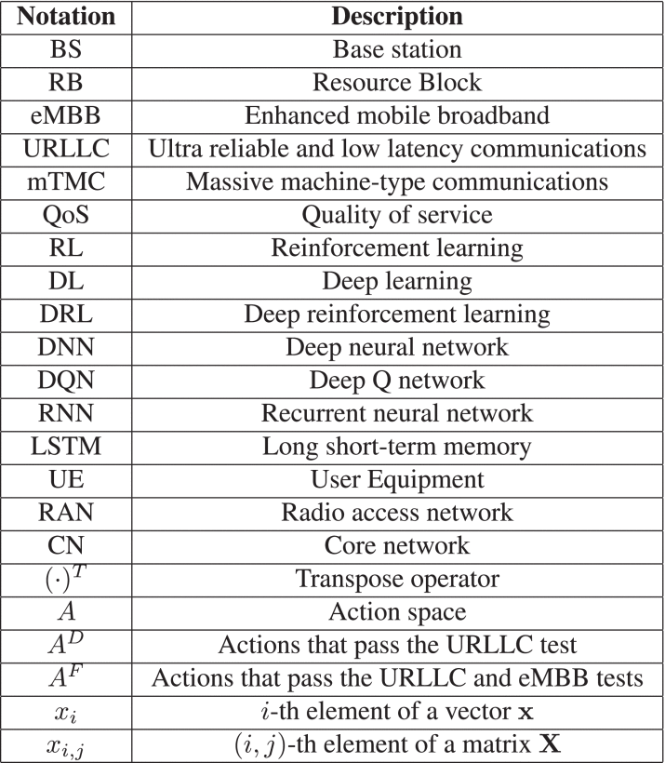
Coexistence of eMBB, URLLC, and mMTC needs to be handled properly by the base station (BS) and 5G core network including access and mobility management function(AMF), session management function (SMF), and userplane function (UPF).
However, it is in general very difficult to satisfy these diverse service requirements simultaneously since the goal of each service category is dearly distinct.
For example, to meet the latency requirement of the URLLC service,the BS should transmit the URLLC packet immediately even in the middle of eMBB/mMTC transmission. In such case, obviously, reception quality of eMBB and mMTC services will be degraded severely due to the abrupt increase in interference.

Slide 5
In order to maximize throughput while maintaining the QOS requirements, several network slicing techniques have been introduced.
A technique in [1], is to allocate equal number of RBs to each network slice.
A technique in [2], uses a regression tree- based technique to assign different bandwidth to each network slice based on service requirement.
Though these techniques are useful but they are unable to handle the resource allocation in a dynamic wireless environment, because with each alteration one has to deal with the exponential computational complexity.
[1] C. Bektas, S. Bocker, F. Kurtz, and C. Wietfeld, ‘‘Reliable software-defined
RAN network slicing for mission-critical 5G communication networks,’’
[2] N. Salhab, R. Rahim, R. Langar, and R. Boutaba, ‘‘Machine learning
based resource orchestration for 5G network slices,’’ in Proc. IEEE Global
Commun. Conf. (GLOBECOM), Waikoloa, HI, USA, Dec. 2019, pp. 1–6.

Slide 6
This paper proposes a DRL-based network slicing (DRL-NS)technique.
The idea is to employ the DRL with a sequential decision- making problem.
Using DRL to let the gNB (agent)observe the channel state, data rate constraints, delay requirements(states), and then assign each resource block (RB)to a certain service (action) to maximize the overall system throughput (reward).
Action Elimination technique[1] is used to reduce the action space from which the agent is choosing the actions to take for the allocation.
This assists in excluding undesirable actions among all possible actions to boost up the training speed and quality of trained policy.
DRL-NS achieves about 25% and 15% improvements in the throughput performance over the equal allocation and regression-tree-based network slicing techniques, respectively.
Even when compared to the vanilla DQN-based network slicing technique, DRL-NS achieves around 10%improvement in the throughput performance.
[1] T. Zahavy, M. Haroush, N. Merlis, D. J. Mankowitz, and S. Mannor, ‘‘Learn what not to learn: Action elimination with deep reinforcement learning,’’ in Proc. Adv. Neural Inform. Process. Syst., 2018, pp. 3562–3573

Slide 7
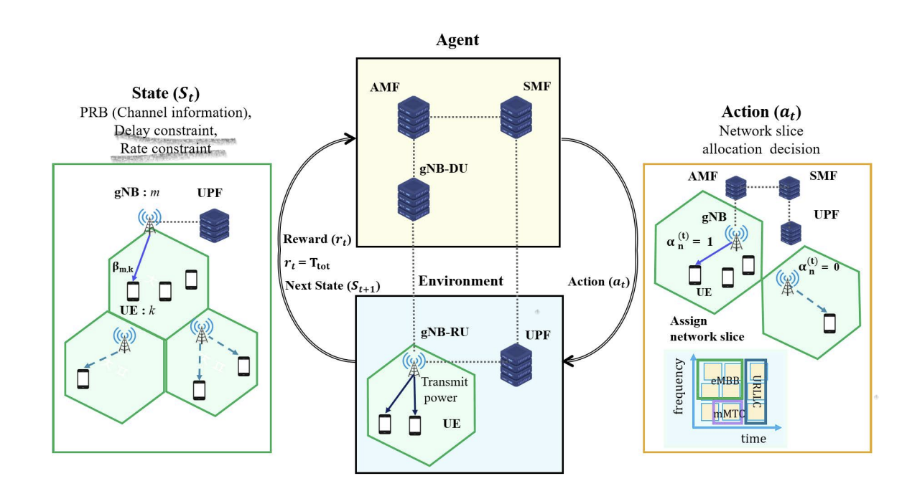

Slide 8
Related Work
S. Kim and B. Shim, ‘‘Localization of Internet of Things network via deep neural network based matrix completion,’’ in Proc. Int. Conf. Inf. Commun. Technol. Converg. (ICTC), Oct. 2020, pp. 1766–1770.
R. Peter, C. Mannweiler, D. S. Michalopoulos, C. Sartori, V. Sciancalepore, N. Sastry, O. Holland, S. Tayade, B. Han, D. Bega, D. Aziz, and H. Bakker, ‘‘Network slicing to enable scalability and flexibility in 5G mobile networks,’’ IEEE Commun. Mag., vol. 55, no. 5, pp. 72–79, May 2017.
N. Salhab, R. Rahim, R. Langar, and R. Boutaba, ‘‘Machine learning based resource orchestration for 5G network slices,’’ in Proc. IEEE Global Commun. Conf. (GLOBECOM), Waikoloa, HI, USA, Dec. 2019, pp. 1–6.
C. Bektas, S. Bocker, F. Kurtz, and C. Wietfeld, ‘‘Reliable software-defined RAN network slicing for mission-critical 5G communication networks,’’ in Proc. IEEE Globecom Workshops (GC Wkshps), Dec. 2019, pp. 1–6.
H. Ju, S. Kim, Y. Kim, H. Lee, and B. Shim, ‘‘Energy-efficient ultradense network using deep reinforcement learning,’’ in Proc. IEEE 21st Int. Workshop Signal Process. Adv. Wireless Commun. (SPAWC), May 2020, pp. 1–5.
V. Mnih, K. Kavukcuoglu, D. Silver, A. A. Rusu, and J. Veness, ‘‘Humanlevel control through deep reinforcement learning,’’ Nature, vol. 518, no. 7540, p. 529, 2015.
T. Zahavy, M. Haroush, N. Merlis, D. J. Mankowitz, and S. Mannor, ‘‘Learn what not to learn: Action elimination with deep reinforcement learning,’’ in Proc. Adv. Neural Inform. Process. Syst., 2018, pp. 3562–3573.

Slide 9
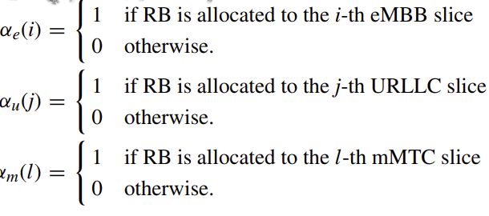
System model
A network slice model in downlink transmission scenario and specify three types of slices: eMBB, URLLC, mMTC
A downlink transmission scenario where M BSs serve K UEs.
The model used in the experiment is a Rayleigh fading channel model, one of the most widely used channel model.
There are total N network slices which are divided in the three categories. As I(eMBB),J(URLLC),L(mMTC). I+J+L = N

Slide 10
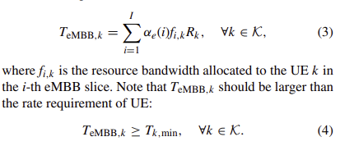


Network Slicing problem
eMMB
Condition for URLLC
T (t) total = T (t) eMBB + T (t) URLLC + T (t) mMTC.

Slide 11
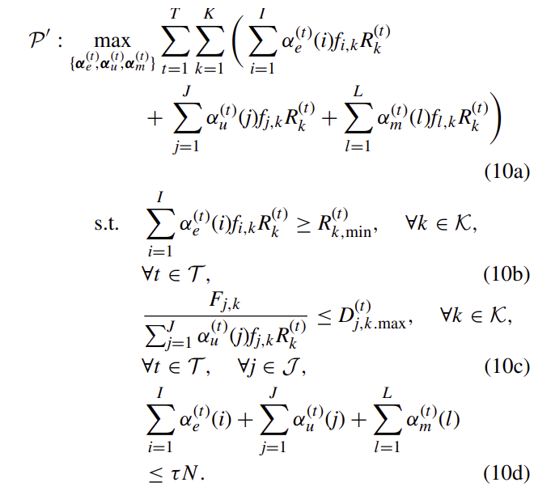
Problem is a mixed-integer programming, which is known as a non-convex NP-hard problem.

Slide 12
DRL-NS model
A whole network consisting of M BSs and K UEs is considered as an environment and the gNB is serving as an agent.
State space:
The minimum rate constraints of UEs R (t) min = [R (t) 1,min, · · · , R (t) K,min] T at the time slot t.
The slice allocation decision at the previous time slot α(t−1) =[α(t−1)1, · · · , α(t−1)N]T
The channel matrix H(t) representing the path loss and the shadowing effect between BSs and UEs at the time slot t. To be specific, H(t) is expressed as M × K matrix
The maximum delay constraints of UE at the time slot t is expressed as J × K matrix
state = [H(t), H(t−1), R(t)min, D(t)max, α(t−1)]T
Both H(t) and H(t−1) are included in state so that the DNN in DRL agent can extract the temporally correlated features of the channel information.

Slide 13
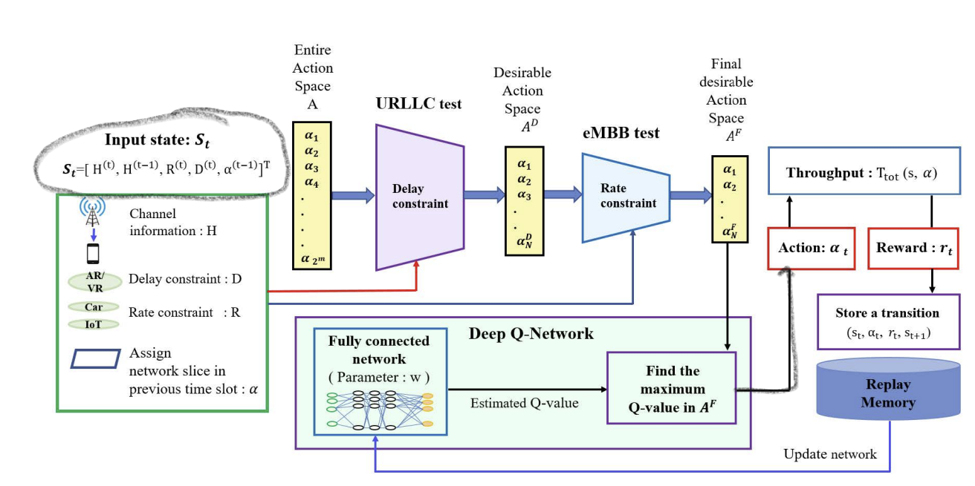

Slide 14
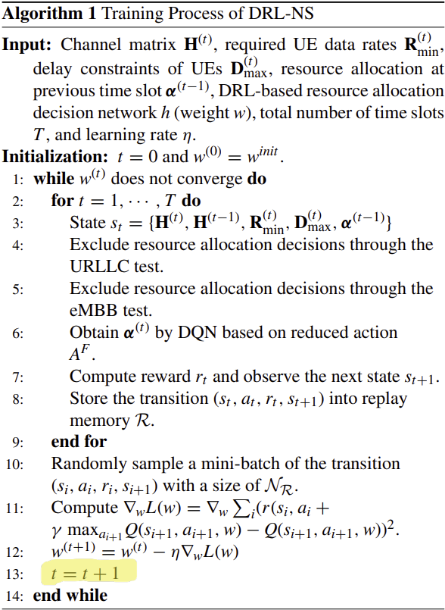
Training Algorithm

Slide 15
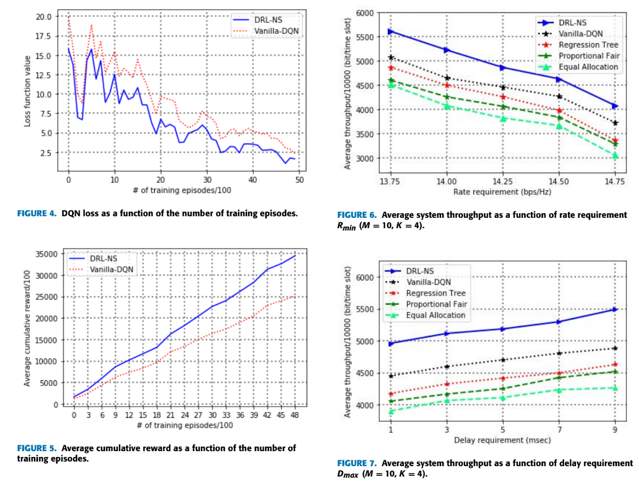
Simulation Results

Slide 16
Conclusion
Using the action elimination technique, the sample space from which the combinations are selected can be reduced and hence, the training of the model can be enhanced and provide better throughput results using the DQN in DRL-NS technique.

Slide 17
Thank you

